Slide 1
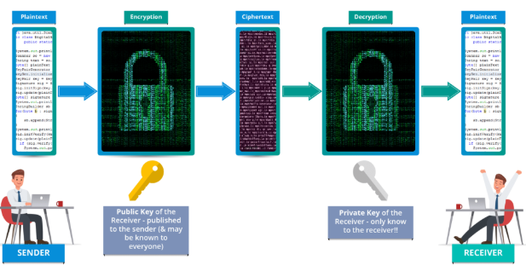
Cryptography

Slide 2
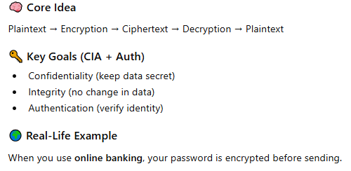
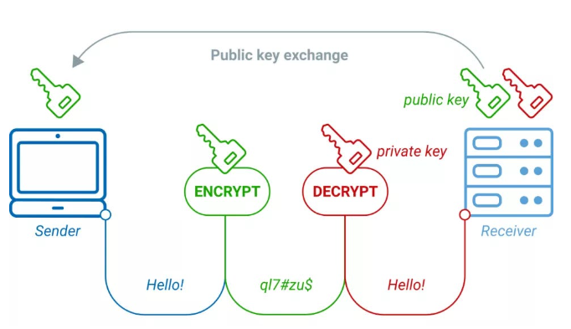
Cryptography
Cryptography is the technique of protecting information by converting it into an unreadable form.
Cryptography (“secret writing”): Making secret messages - Turning plaintext (an ordinary readable message) into ciphertext (secret messages that are “hard” to read)
Cryptanalysis: Breaking secret messages - Recovering the plaintext from the cipher text
Cryptology is the science which studies these both -The point of cryptography is to send secure messages over an insecure medium (like the Internet)

Slide 3
The Simple Analogy: A Lockbox
Imagine you want to send a secret letter to a friend through a messenger.
The Key: A specific number or password (e.g., "Shift by 3" or a digital code).
Encryption (Locking): You put the letter in a box and use the Key to lock it.
Decryption (Unlocking): Your friend uses the same Key (or a matching one) to unlock the box and read the letter.

Slide 4

Encryption (The Locking Process)
The process of converting readable data (plaintext) into unreadable, scrambled data (ciphertext).
Purpose: To hide the original information.
What it does: Uses an algorithm (a mathematical formula) and a Key to scramble the data.
Example:

Slide 5

Decryption (The Unlocking Process)
The reverse process—converting the scrambled ciphertext back into readable plaintext.
Purpose: To recover the original information.
What it does: Uses the same algorithm (in reverse) and the Key to unscramble the data.
Example:

Slide 6


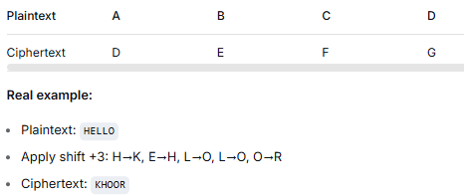
History of Encryption
Early Methods
1. Caesar Cipher (shift letters)
How it works:
Replace each letter in your message with a letter that is a fixed number of places down the alphabet.
Example (Shift = 3 to the right):
Problem: Easy to break — just try all 25 possible shifts (brute force).

Slide 7
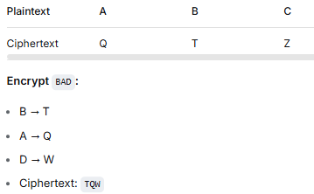
History of Encryption
Substitution Ciphers (more complex than Caesar)
How it works:
Randomly map each letter to another letter (not just a shift).
Example: A→Q, B→T, C→Z, etc.
Example (random substitution):
Key: The entire substitution table (A→Q, B→T, etc.).
Problem: Still breakable using frequency analysis (e.g., 'E' is most common letter in English).

Slide 8
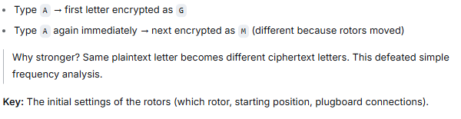
Modern Evolution
Mechanical machines (Enigma)
What it was:
A machine with rotating rotors that changed the substitution pattern every time you typed a letter.
Example logic:

Slide 9
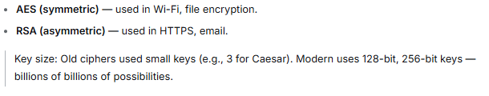
Modern Evolution
Computer-based encryption
What changed:
Computers can do complex math instantly. Modern encryption uses mathematical problems that are easy to do but extremely hard to reverse without the key.
Examples: Advanced Encryption Standard / Rivest–Shamir–Adleman

Slide 10
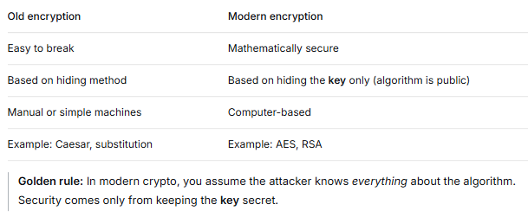
Summary

Slide 11
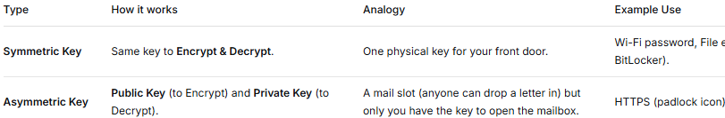
The Key (The Secret Ingredient)
A piece of secret information (a string of letters, numbers, or bits) used by the algorithm to encrypt and decrypt.
Purpose: The key determines the specific output of the encryption. The algorithm (e.g., AES, RSA) is public and well-known, but the Key is private.
Analogy: The lock design (the algorithm) is the same for millions of people. But the unique shape of your key makes your lock unique.
Types of Keys:

Slide 12
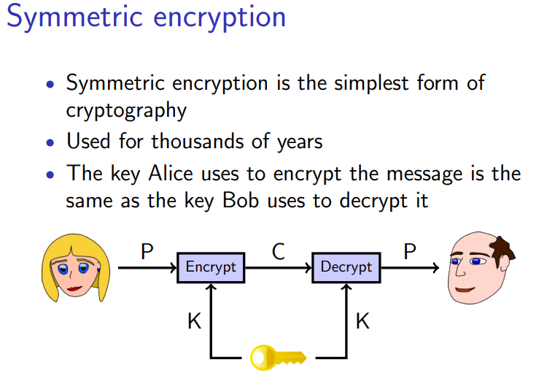

Slide 13
Asymmetric Encryption (Public-Key Cryptography)
Uses two different but mathematically linked keys: a public key (for encryption) and a private key (for decryption). The public key can be shared openly; the private key must be kept secret.
Characteristics:
Slower than symmetric (100–1000× slower).
Solves the key distribution problem.
Enables digital signatures and non-repudiation.
Examples: RSA, ECC, ElGamal, DSA.

Slide 14
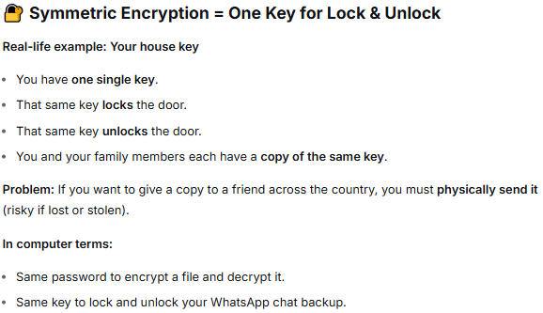
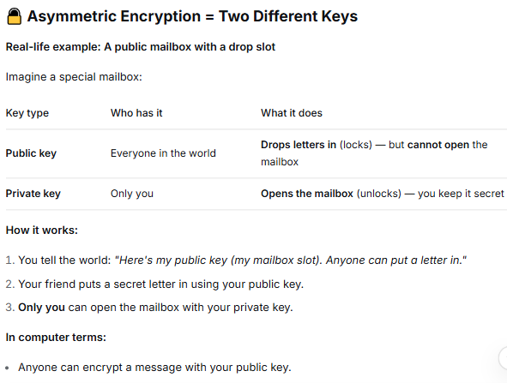
Example for Understanding

Slide 15
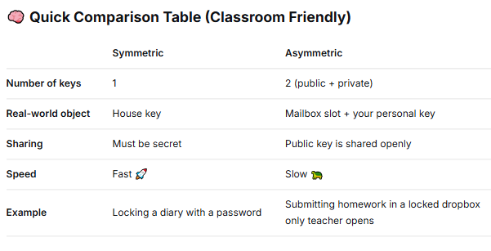

Slide 16
Legitimate vs. Fraudulent Encryption
The authorized, lawful use of encryption to protect data confidentiality, integrity, and privacy for legal purposes.
The malicious or criminal use of encryption to hide illegal activities, commit fraud, or deny access to rightful owners (e.g., ransomware).
Key idea: Encryption itself is neutral — like a knife. It can be used to slice bread (legitimate) or to harm someone (fraudulent). The intent and context determine legitimacy.

Slide 17
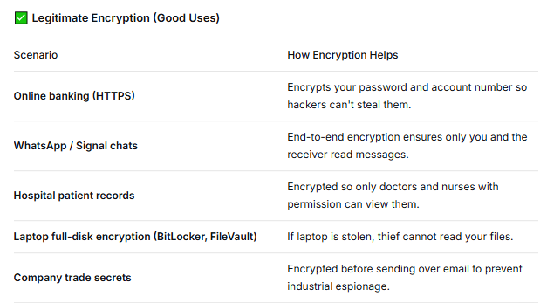

Slide 18
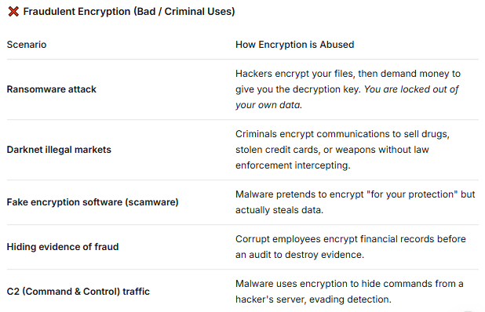

Slide 19
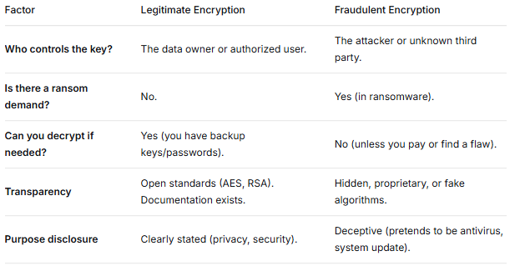

Slide 20
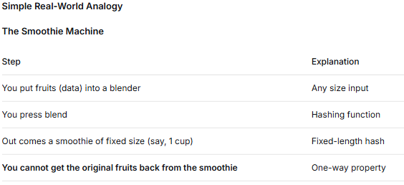
Hashing
It is a one-way mathematical function that takes any amount of data and produces a fixed-length "fingerprint" called a hash value or digest. You cannot reverse a hash to get the original data.

Slide 21
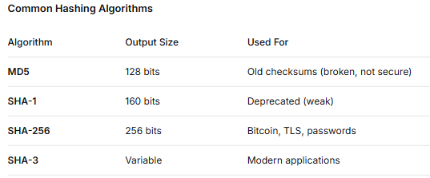
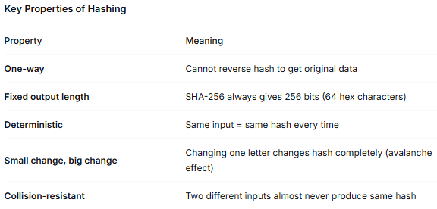
Example:
You download: Ubuntu.iso
Website shows: SHA-256: 3b3d6f...9c4a2e
You run hash on your downloaded file:
If match → File is exactly as intended (not tampered, no corruption)
If different → File is corrupted or infected
"Hashing tells you if something has changed. It doesn't hide the data — it fingerprints it."

Slide 22
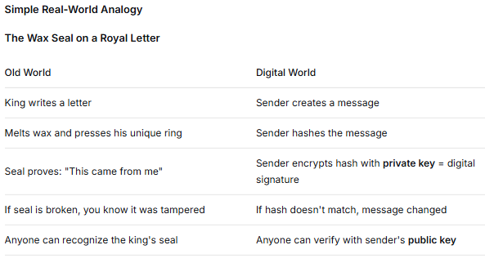
Digital Signature (The Electronic Seal)
A Digital Signature is a cryptographic technique that uses asymmetric encryption (public/private keys) to prove that a message or document came from a specific sender and has not been altered. It provides authenticity, integrity, and non-repudiation.

Slide 23
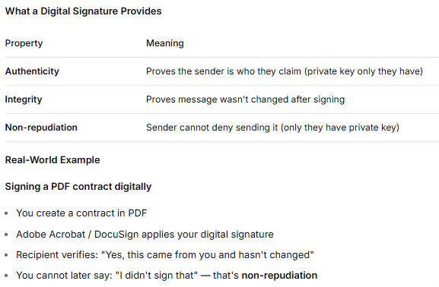

Slide 24
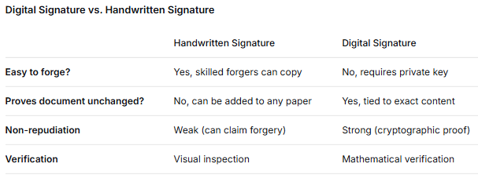

Slide 25
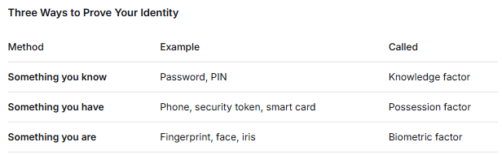
Authentication (Proving Who You Are)
Authentication is the process of verifying that someone or something is who they claim to be. It answers the question: "Are you really you?”

Slide 26
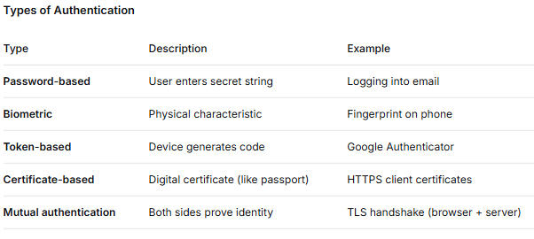

Slide 27
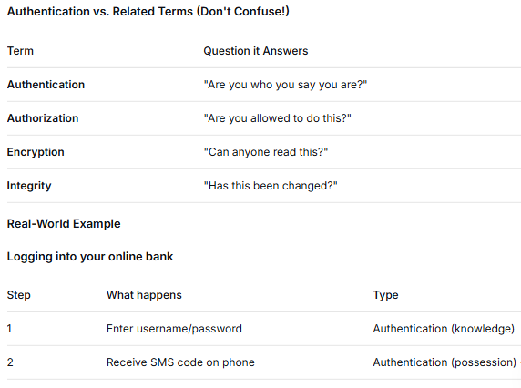

Slide 28
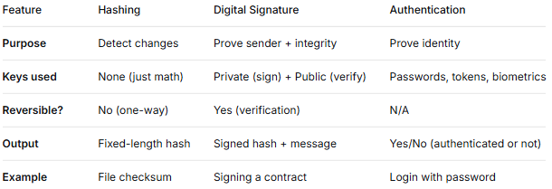

Slide 29
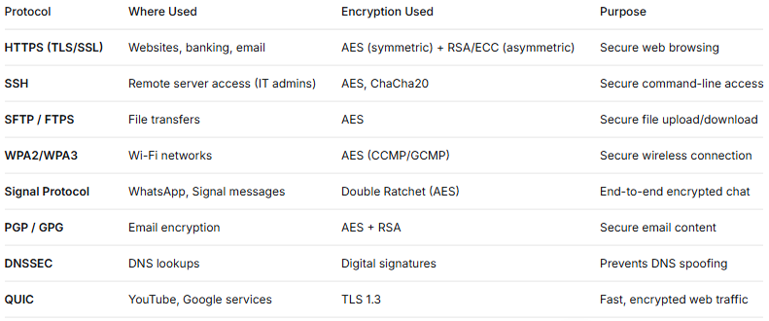
Encryption Used in the Internet (Everyday Life)

Slide 30
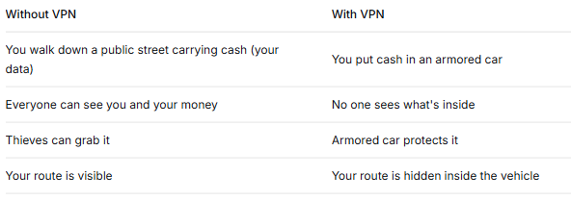
Virtual Private Network (VPN)
A Virtual Private Network (VPN) creates an encrypted "tunnel" between your device and a remote server, hiding your internet traffic from your ISP, hackers, and government surveillance. It makes it appear as if you are located where the VPN server is.

Slide 31
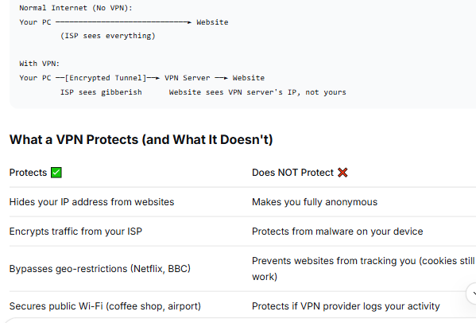

Slide 32
VPN Protocols - PPTP, L2TP, IPsec
PPTP (Point-to-Point Tunneling Protocol)
PPTP is one of the oldest VPN protocols, created by Microsoft in 1995. It wraps PPP (Point-to-Point Protocol) packets in IP packets and sends them over the internet.
L2TP (Layer 2 Tunneling Protocol)
L2TP is a tunneling protocol that creates a VPN connection but provides no encryption by itself. It is always paired with IPsec to add security. Together they are called L2TP/IPsec.
IPsec (Internet Protocol Security)
IPsec is a suite of protocols that encrypts and authenticates IP packets at the network layer (Layer 3 of OSI model). It can operate in two modes: Transport Mode (encrypts only data) and Tunnel Mode (encrypts entire packet).

Slide 33
